Slide 1
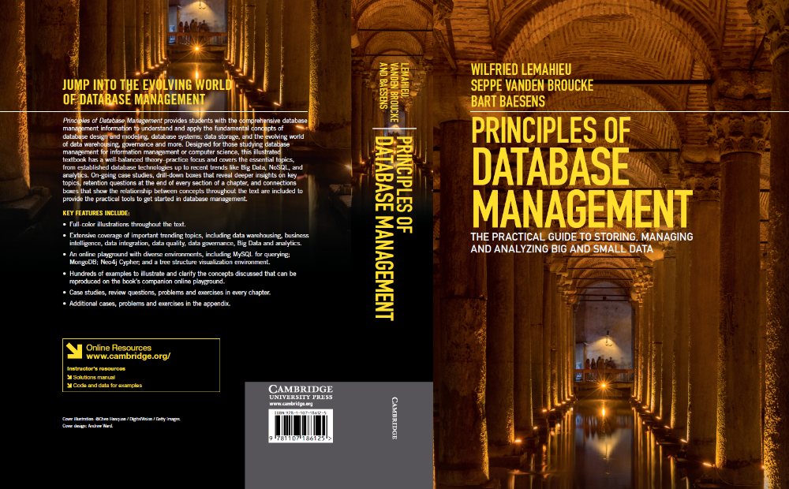
XML Databases
www.pdbmbook.com

Slide 2
Introduction
Extensible Markup Language
Processing XML Documents
Storage of XML Documents
Differences between XML and Relational Data
Mappings Between XML Documents and (Object-) Relational Data
Searching XML Data
XML for Information Exchange
Other Data Representation Formats

Slide 3
Extensible Markup Language
Basic Concepts
Document Type Definitions and XML Schema Definitions
Extensible Stylesheet Language
Namespaces
XPath

Slide 4
Basic Concepts of XML
Introduced by the World Wide Web Consortium (W3C) in 1997
Simplified subset of the Standard Generalized Markup Language (SGML),
Aimed at storing and exchanging complex, structured documents
Users can define new tags in XML (↔ HTML)

Slide 5
Basic Concepts of XML
Combination of a start tag, content and end tag is called an XML element
XML is case-sensitive
Example
<author>
<name>
<first name>Bart</first name>
<last name>Baesens</last name>
</name>
</author>

Slide 6
Basic Concepts of XML
Start tags can contain attribute values
<author email="Bart.Baesens@kuleuven.be">Bart Baesens</author>
<author>
<name>Bart Baesens</name>
<email use="work">Bart.Baesens@kuleuven.be</email>
<email use="private">Bart.Baesens@gmail.com</email>
</author>
Comments are defined as follows
<!--This is a comment line -->
Processing instructions are defined as follows
<?xml version="1.0" encoding="UTF-8"?>

Slide 7
Basic Concepts of XML
Self-defined XML tags can be used to describe document structure (↔ HTML)
  can be processed in much more detail
XML formatting rules
  only one-root element
  start tag should be closed with a matching end tag
  no overlapping tag sequence or incorrect nesting

Slide 8
Basic Concepts of XML
<?xml version="1.0" encoding="UTF-8"?>
<winecellar>
<wine>
<name>Jacques Selosse Brut Initial</name>
<year>2012</year>
<type>Champagne</type>
<grape percentage="100">Chardonnay</grape>
<price currency="EURO">150</price>
<geo>
<country>France</country>
<region>Champagne</region>
</geo>
<quantity>12</quantity>
</wine>
<wine>
<name>Meneghetti White</name>
<year>2010</year>
<type>white wine</type>
<grape percentage="80">Chardonnay</grape>
<grape percentage="20">Pinot Blanc</grape>
<price currency="EURO">18</price>
<geo>
<country>Croatia</country>
<region>Istria</region>
</geo>
<quantity>20</quantity>
</wine>
</winecellar>

Slide 9
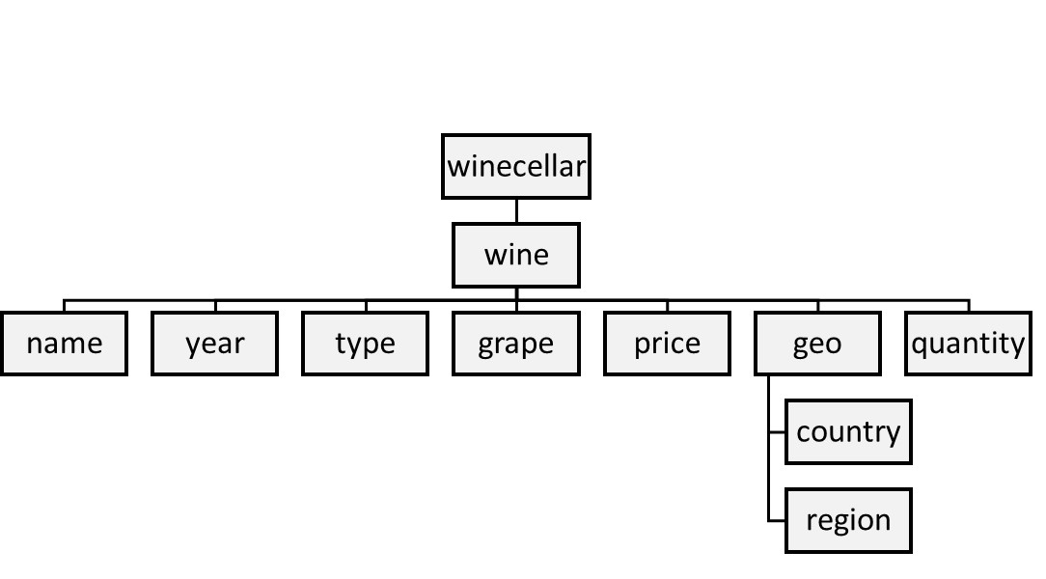
Basic Concepts of XML

Slide 10
Document Type Definitions and XML Schema Definitions
Document Type Definitions (DTD) and XML Schema Definitions (XSD) specify structure of XML document
Both define tag set, location of each tag, and nesting
XML document which complies with DTD or XSD is referred to as valid
XML document which complies with syntax is referred to as well-formed

Slide 11
Document Type Definitions and XML Schema Definitions
DTD definition for winecellar
<?xml version="1.0" encoding="UTF-8"?>
<!DOCTYPE winecellar [
<!ELEMENT winecellar (wine+)>
<!ELEMENT wine (name, year, type, grape*, price, geo, quantity)>
<!ELEMENT name (#PCDATA)>
<!ELEMENT year (#PCDATA)>
<!ELEMENT type (#PCDATA)>
<!ELEMENT grape (#PCDATA)>
<!ATTLIST grape percentage CDATA #IMPLIED>
<!ELEMENT price (#PCDATA)>
<!ATTLIST price currency CDATA #REQUIRED>
<!ELEMENT geo (country, region)>
<!ELEMENT country (#PCDATA)>
<!ELEMENT region (#PCDATA)>
<!ELEMENT quantity (#PCDATA)>
]>

Slide 12
Document Type Definitions and XML Schema Definitions
Disadvantages of DTD
  only supports character data (no support for integers, dates, complex types)
  not defined using XML syntax
XML Schema supports various data types and user-defined types

Slide 13
Document Type Definitions and XML Schema Definitions
XML Schema definition for winecellar
<?xml version="1.0" encoding="UTF-8" ?>
<xs:schema xmlns:xs="http://www.w3.org/2001/XMLSchema">
<xs:element name="winecellar">
<xs:complexType>
<xs:sequence>
<xs:element name="wine" maxOccurs="unbounded" minOccurs="0">
<xs:complexType>
<xs:sequence>
<xs:element type="xs:string" name="name"/>
<xs:element type="xs:short" name="year"/>
<xs:element type="xs:string" name="type"/>
<xs:element name="grape" maxOccurs="unbounded" minOccurs="1">
<xs:complexType>
<xs:simpleContent>
<xs:extension base="xs:string">
<xs:attribute type="xs:byte" name="percentage" use="optional"/>
</xs:extension>
</xs:simpleContent>

Slide 14
Document Type Definitions and XML Schema Definitions
XML Schema definition for winecellar (contd.)
</xs:complexType>
</xs:element>
<xs:element name="price">
<xs:complexType>
<xs:simpleContent>
<xs:extension base="xs:short">
<xs:attribute type="xs:string" name="currency" use="optional"/>
</xs:extension>
</xs:simpleContent>
</xs:complexType>
</xs:element>
<xs:element name="geo">
<xs:complexType>
<xs:sequence>
<xs:element type="xs:string" name="country"/>
<xs:element type="xs:string" name="region"/>
</xs:sequence>

Slide 15
Document Type Definitions and XML Schema Definitions
XML Schema definition for winecellar (contd.)
</xs:complexType>
</xs:element>
<xs:element type="xs:byte" name="quantity"/>
</xs:sequence>
</xs:complexType>
</xs:element>
</xs:sequence>
</xs:complexType>
</xs:element>
</xs:schema>

Slide 16
Extensible Stylesheet Language
Extensible Stylesheet Language (XSL) can be used to define stylesheet specifying how XML documents can be visualized in a web browser
XSL encompasses 2 specifications
  XSL Transformations (XSLT): transforms XML documents to other XML documents, HTML web pages, or plain text
  XSL Formatting Objects (XSL-FO): specify formatting semantics (e.g., transform XML documents to PDFs) but discontinued in 2012
Decoupling of information content from information visualization

Slide 17
Extensible Stylesheet Language
XSLT stylesheet for summary document with only name and quantity of each wine
<?xml version="1.0" encoding="UTF-8"?>
<xsl:stylesheet version="1.0" xmlns:xsl="http://www.w3.org/1999/XSL/Transform">
<xsl:template match='/'>
<winecellarsummary>
<xsl:for-each select='winecellar/wine'>
<wine>
<name><xsl:value-of select='name'/></name>
<quantity><xsl:value-of select='quantity'/></quantity>
</wine>
</xsl:for-each>
</winecellarsummary>
</xsl:template>
</xsl:stylesheet>

Slide 18
Extensible Stylesheet Language
<?xml version="1.0" encoding="UTF-8"?>
<winecellarsummary>
<wine>
<name>Jacques Selosse Brut Initial</name>
<quantity>12</quantity>
</wine>
<wine>
<name>Meneghetti White</name>
<quantity>20</quantity>
</wine>
</winecellarsummary>

Slide 19
Extensible Stylesheet Language
XSLT stylesheet for transforming XML document to HTML
<?xml version="1.0" encoding="UTF-8"?>
<html xsl:version="1.0" xmlns:xsl="http://www.w3.org/1999/XSL/Transform">
<body style="font-family:Arial;font-size:12pt;background-color:#ffff">
<h1>My Wine Cellar</h1>
<table border="1">
<tr bgcolor="#f2f2f2">
<th>Wine</th>
<th>Year</th>

Slide 20
Extensible Stylesheet Language
XSLT stylesheet for transforming XML document to HTML (contd.)
<th>Quantity</th>
</tr>
<xsl:for-each select="winecellar/wine">
<tr>
<td><xsl:value-of select="name"/></td>
<td><xsl:value-of select="year"/></td>
<td><xsl:value-of select="quantity"/></td>
</tr>
</xsl:for-each>
</table>
</body>
</html>

Slide 21
Extensible Stylesheet Language
<html>
<body style="font-family:Arial;font-size:12pt;background-color:#ffff">
<h1>My Wine Cellar</h1>
<table border="1">
<tr bgcolor="#f2f2f2">
<th>Wine</th>
<th>Year</th>
<th>Quantity</th>
</tr>
<tr>
<td>Jacques Selosse Brut Initial</td>
<td>2012</td>
<td>12</td>
</tr>
<tr>
<td>Meneghetti White</td>
<td>2010</td>
<td>20</td>
</tr>
</table> </body></html>

Slide 22
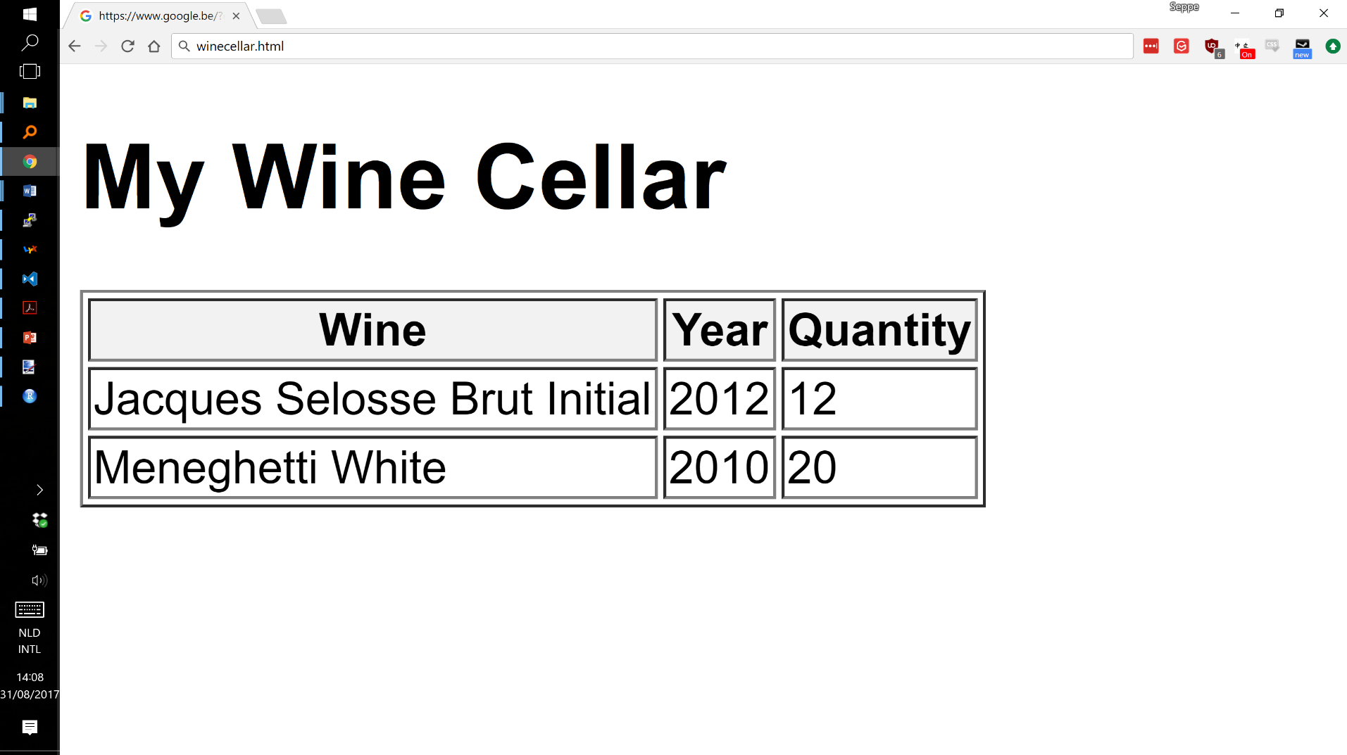
Extensible Stylesheet Language

Slide 23
Namespaces
To avoid name conflicts, XML introduced concept of a namespace
Introduce prefixes to XML elements to unambiguously identify their meaning
Prefixes typically refer to a URI (uniform resource identifier) which uniquely identifies a web resource such as a URL (uniform resource locator)
  does not need to refer to physically existing webpage

Slide 24
Namespaces
<winecellar xmlns:Bartns="www.dataminingapps.com/home.html">
<bartns:wine>
<bartns:name>Jacques Selosse Brut Initial</bartns:name>
<bartns:year>2012</bartns:year>
</bartns:wine>
<winecellar xmlns="www.dataminingapps.com/defaultns.html">

Slide 25
XPath
XPath is a simple, declarative language that uses path expressions to refer to parts of an XML document
  considers an XML document as an ordered tree
Example XPath expressions
doc("winecellar.xml")/winecellar/wine
doc("winecellar.xml")/winecellar/wine[2]
doc("winecellar.xml")/winecellar/wine[price > 20]/name

Slide 26
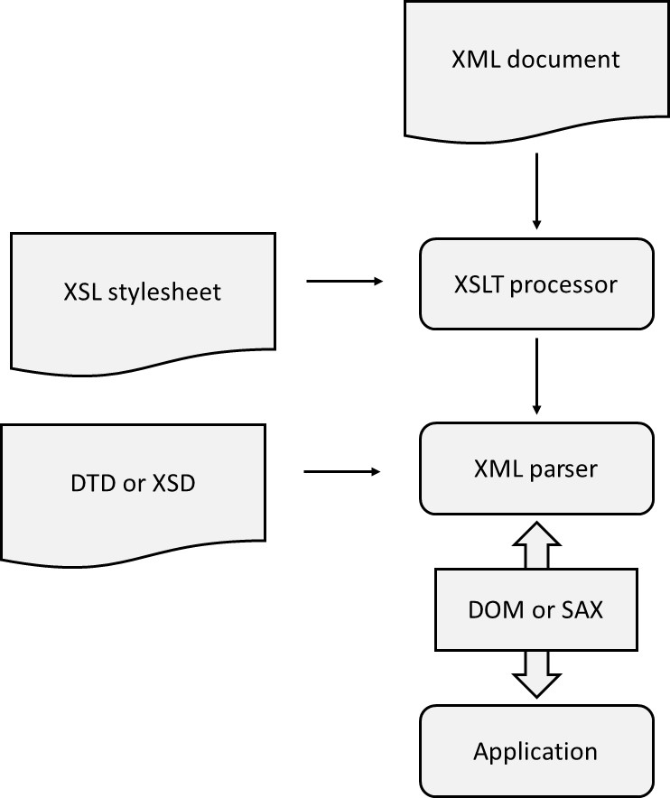
Processing XML Documents

Slide 27
Processing XML Documents
DOM API is a tree-based API and represents XML document as a tree in internal memory
  developed by W3C
DOM provides classes with methods to navigate through the tree and do various operations
DOM is useful to facilitate direct access to specific XML document parts and when a high number of data manipulations are needed, but can get memory intensive

Slide 28
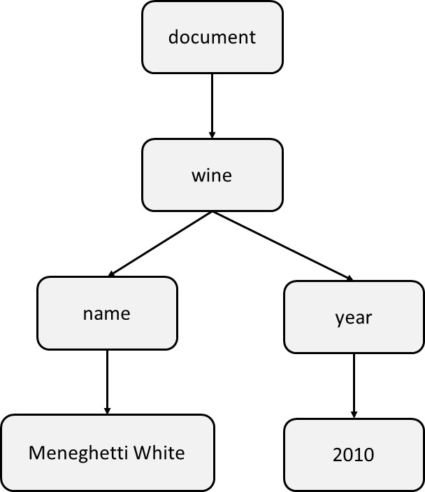
Processing XML Documents
<wine>
<name>Meneghetti White<name>
<year>2010<year>
<wine>

Slide 29
Processing XML Documents
SAX API (Simple API for XML) is an event-based API
start document
start element: wine
start element: name
text: Meneghetti
end element: name
start element: year
text: 2010
end element: year
end element: wine
end document

Slide 30
Processing XML Documents
Event stream can be passed on to application which will use an event handler
SAX has smaller memory footprint and is more scalable than DOM
SAX is excellent for sequential access, but less suited to support direct random access
SAX is less performing for heavy data manipulation than DOM
StAX (Streaming API for XML) is a compromise
  StAX allows the application to pull XML data using a cursor mechanism

Slide 31
Storage of XML Documents
XML documents stored as semi-structured data
Approaches
  document-oriented approach
  data-oriented approach
  combined approach

Slide 32
Document-Oriented Approach for Storing XML Documents
XML document will be stored as a BLOB or CLOB in a table cell
  RDBMS considers these as ‘black box’ data
  querying based upon full-text search
  (O)RDBMSs have introduced XML data type (SQL/XML extension)
Simple approach
  no need for DTD or XSD for the XML document
  especially well-suited for storing static content
  but: poor integration with relational SQL query processing

Slide 33
Data-Oriented Approach for Storing XML Documents
XML document decomposed into data parts spread across a set of connected (object-) relational tables (shredding)
For highly structured documents and fine-granular queries
DBMS or middleware can do translation
Schema-oblivious shredding (starts from XML document) versus schema-aware shredding (starts from DTD/ XSD)
Advantages
  SQL queries can now directly access individual XML elements
  reconstruct XML document using SQL joins
Object-relational DBMS as an alternative

Slide 34
The Combined Approach for Storing XML Documents
Combined approach (partial shredding) combines document- and data-oriented approach
Some parts stored as BLOBs, CLOBs, or XML objects, whereas other parts shredded
SQL views are defined to reconstruct XML document
Most DBMSs provide facilities to determine optimal level of decomposition
Mapping approaches can be implemented using middleware or by DBMS (XML-enabled DBMS)

Slide 35
Differences Between XML Data and Relational Data
Building block of relational model is mathematical relation which consists of 0, 1 or more unordered tuples
Each tuple consists of 1 or more attributes
The relational model does not implement any type of ordering (↔ XML model)
  add extra attribute type in RDBMS
  use list collection type in object-relational DBMS

Slide 36
Differences Between XML Data and Relational Data
Relational model does not support nested relations (first normal form)
  ↔ XML data is hierarchically structured
  object-relational DBMS supports nested relations
Relational model does not support multivalued attribute types (first normal form)
  ↔ XML allows same child element to appear multiple times
  additional table needed in relational model
  object-relational model supports collection types

Slide 37
Differences Between XML Data and Relational Data
RDBMS only supports atomic data types, such as integer, string, date, etc.
  XML DTDs don’t support atomic data types (only (P)CDATA)
  XML Schema supports both atomic and aggregated types
  aggregated types modeled in object-relational databases using user defined types
XML data is semi-structured
  can include certain anomalies
  change to DTD or XSD necessitates re-generation of tables

Slide 38
Mappings Between XML Documents and (Object-) Relational Data
Table-Based Mapping
Schema-Oblivious Mapping
Schema-Aware Mapping
SQL/XML

Slide 39
Table-Based Mapping
Specifies strict requirements to the structure of the XML document
<database>
<table>
<row>
<column1> data </column1>
…
</row>
<row>
<column1> data </column1>
…
</row>
…
</table>
<table>
…
</table>
…
</database>

Slide 40
Table-Based Mapping
Actual data is stored as content of column elements
Advantage is simplicity given the perfect one-to-one mapping
Document structure can be implemented using an updatable SQL view
Disadvantage is rigid structure of XML document
  can be mitigated by XSLT

Slide 41
Schema-Oblivious Mapping
Schema-oblivious mapping (shredding) transforms XML document without availability of DTD or XSD
First option is to transform the document to a tree structure, whereby the nodes represent the data in the document
  tree can then be mapped to a relational model
Example table
CREATE TABLE NODE(
ID CHAR(6) NOT NULL PRIMARY KEY,
PARENT_ID CHAR(6),
TYPE VARCHAR(9),
LABEL VARCHAR(20),
VALUE CLOB,
FOREIGN KEY (PARENT_ID) REFERENCES NODE (ID)
CONSTRAINT CC1 CHECK(TYPE IN ("element", "attribute")));

Slide 42
Schema-Oblivious Mapping
ID | PARENT_ID | TYPE | LABEL | VALUE
1 | NULL | element | winecellar | NULL
2 | 1 | element | wine | NULL
3 | 2 | attribute | winekey | 1
4 | 2 | element | name | Jacques Selosse Brut Initial
5 | 2 | element | year | 2012
6 | 2 | element | type | Champagne
7 | 2 | element | price | 150
8 | 1 | element | wine | NULL
9 | 8 | attribute | winekey | 2
10 | 8 | element | name | Meneghetti White
11 | 8 | element | year | 2010
12 | 8 | element | type | white wine
13 | 8 | element | price | 18
<?xml version="1.0" encoding="UTF-8"?>
<winecellar>
<wine winekey="1">
<name>Jacques Selosse Brut Initial</name>
<year>2012</year>
<type>Champagne</type>
<price>150</price>
</wine>
<wine winekey="2">
<name>Meneghetti White</name>
<year>2010</year>
<type>white wine</type>
<price>18</price>
</wine>
</winecellar>

Slide 43
Schema-Oblivious Mapping
XPath or XQuery (see later) queries can be translated into SQL of which the result can be translated back to XML
Example
doc("winecellar.xml")/winecellar/wine[price > 20]/name
SELECT N2.VALUE
FROM NODE N1, NODE N2
WHERE
N2.LABEL="name" AND
N1.LABEL="price" AND
CAST(N1.VALUE AS INT)> 20 AND
N1.PARENT_ID=N2.PARENT_ID

Slide 44
Schema-Oblivious Mapping
Single table requires extensive querying (e.g., self-joins)
More tables can be created
Mapping can be facilitated by making use of object-relational extensions
Due to extensive shredding, reconstruction of XML document can get quite resource intensive
  middleware solutions offer DOM API or SAX API on top of DBMS
  materialized views

Slide 45
Schema-Aware Mapping
Steps to generate database schema from DTD or XSD
  simplify DTD or XSD
  map complex element type to relational table, or user-defined type, with corresponding primary key
  map element type with mixed content to separate table where the (P)CDATA is stored; connect using primary-foreign key relationship
  map single-valued attribute types, or child elements that occur only once, with (P)CDATA content to a column in the corresponding relational table; when starting from XSD, choose the SQL data type which most closely resembles
  map multi-valued attribute types, or child elements that can occur multiple times, with (P)CDATA content to a separate table; use primary-foreign key relationship; use collection type in case of object-relational DBMS
  for each complex child element type, connect the tables using a primary-foreign key relationship

Slide 46
Schema-Aware Mapping
Generate a DTD or XSD from a database model
  map every table to an element type
  map every table column to an attribute type or child element type with (P)CDATA in case of DTD, or most closely resembling data type in case of XML Schema
  map primary-foreign key relationships by introducing additional child element types
  object-relational collections can be mapped to multivalued attribute types or element types which can occur multiple times

Slide 47
SQL/XML
Extension of SQL which introduces
  new XML data type with corresponding constructor that treats XML documents as cell values in a column of a relational table, and can be used to define attribute types in user-defined types, variables, and parameters of user-defined functions
  set of operators for the XML data type
  set of functions to map relational data to XML
No rules for shredding

Slide 48
SQL/XML
CREATE TABLE PRODUCT(
PRODNR CHAR(6) NOT NULL PRIMARY KEY,
PRODNAME VARCHAR(60) NOT NULL,
PRODTYPE VARCHAR(15),
AVAILABLE_QUANTITY INTEGER,
REVIEW XML);
INSERT INTO PRODUCT VALUES("120", "Conundrum", "white", 12,
XML(<review><author>Bart Baesens</author><date>27/02/2017</date> <description>This is an excellent white wine with intriguing aromas of green apple, tangerine and honeysuckle blossoms.<description><rating max-value="100">94</rating></review>);

Slide 49
SQL/XML
SQL/XML can be used to represent relational data in XML
  default mapping whereby names of tables and columns are translated to XML elements and row elements are included for each table row
  also adds corresponding DTD or XSD
SQL/XML also includes facilities to represent the output of SQL queries in a tailored XML format
  XMLElement defines XML element using 2 arguments: name of XML element and column name

Slide 50
SQL/XML
SELECT XMLElement("sparkling wine", PRODNAME)
FROM PRODUCT
WHERE PRODTYPE="sparkling";
<sparkling wine>Meerdael, Methode Traditionnelle Chardonnay, 2014 </sparkling wine>
<sparkling wine>Jacques Selosse, Brut Initial, 2012</sparkling wine>
<sparkling wine>Billecart-Salmon, Brut Réserve, 2014</sparkling wine>
…

Slide 51
SQL/XML
SELECT XMLElement("sparkling wine", XMLAttributes(PRODNR AS "prodid"), XMLElement("name", PRODNAME), XMLElement("quantity", AVAILABLE_QUANTITY))
FROM PRODUCT
WHERE PRODTYPE="sparkling";
<sparkling wine prodid="0178">
<name>Meerdael, Methode Traditionnelle Chardonnay, 2014</name>
<quantity>136</quantity>
</sparkling wine>
<sparkling wine prodid="0199">
<name>Jacques Selosse, Brut Initial, 2012</name>
<quantity>96</quantity>
</sparkling wine>
…
SELECT XMLElement("sparkling wine", XMLAttributes(PRODNR AS "prodid"), XMLForest(PRODNAME AS "name", AVAILABLE_QUANTITY AS "quantity"))
FROM PRODUCT
WHERE PRODTYPE="sparkling";

Slide 52
SQL/XML
SELECT XMLElement("product", XMLElement(prodid, P.PRODNR), XMLElement("name", P.PRODNAME, XMLAgg("supplier", S.SUPNR))
FROM PRODUCT P, SUPPLIES S
WHERE P.PRODNR=S.PRODNR
GROUP BY P.PRODNR
<product>
<prodid>178</prodid>
<name>Meerdael, Methode Traditionnelle Chardonnay</name>
<supplier>21</supplier>
<supplier>37</supplier>
<supplier>68</supplier>
<supplier>69</supplier>
<supplier>94</supplier>
</product>
<product>
<prodid>199</prodid>
<name>Jacques Selosse, Brut Initial, 2012</name>
<supplier>69</supplier>
<supplier>94</supplier>
</product>
…

Slide 53
SQL/XML
SELECT PRODNR, XMLElement("sparkling wine", PRODNAME), AVAILABLE_QUANTITY
FROM PRODUCT
WHERE PRODTYPE="sparkling";
0178, <sparkling wine>Meerdael, Methode Traditionnelle Chardonnay, 2014</sparkling wine>, 136
0199, <sparkling wine>Jacques Selosse, Brut Initial, 2012</sparkling wine>, 96
0212, <sparkling wine>Billecart-Salmon, Brut Réserve, 2014</sparkling wine>, 141
…

Slide 54
SQL/XML
Template-based mapping
  embed SQL statements in XML documents using tool-specific delimiter (e.g., <selectStmt>)
<?xml version="1.0" encoding="UTF-8"?>
<sparklingwines>
<heading>List of Sparkling Wines</heading>
<selectStmt>
SELECT PRODNAME, AVAILABLE_QUANTITY FROM PRODUCT WHERE PRODTYPE="sparkling";
</selectStmt>
<wine>
<name> $PRODNAME </name>
<quantity> $AVAILABLE_QUANTITY </quantity>
</wine>
</sparklingwines>

Slide 55
SQL/XML
<?xml version="1.0" encoding="UTF-8"?>
<sparklingwines>
<heading>List of Sparkling Wines</heading>
<wine>
<name>Meerdael, Methode Traditionnelle Chardonnay, 2014</name>
<quantity>136</quantity>
</wine>
<wine>
<name>Jacques Selosse, Brut Initial, 2012</name>
<quantity>96</quantity>
</wine>
..
</sparklingwines>

Slide 56
Searching XML Data
Full-text search
Keyword-Based Search
Structured Search with Xquery
Semantic Search with RDF and SPARQL

Slide 57
Full-text search
Treat XML documents as textual data and conduct brute force full-text search
Does not take into account any tag structure
Can be applied to XML documents that have been stored as files or as BLOB/CLOB objects
Usually by means of object-relational extension
No semantically-rich queries targeting individual XML elements

Slide 58
Keyword-Based Search
Assumes XML document is complemented with a set of keywords describing document metadata
Keywords can be indexed by text search engines
Document still stored in a file or as BLOB/CLOB
Still not full expressive power of XML for querying

Slide 59
Structured Search with XQuery
Structured search uses structural metadata which relates to actual document content
E.g., XML book reviews
  document metadata: properties of the document such as, author of the review document (e.g., Wilfried Lemahieu) and creation date (e.g., June 6th, 2017)
  structural metadata: role of individual content fragments within the overall document structure, e.g., title of book ( ‘Analytics in a Big Data World’), author of book (‘Bart Baesens’), …

Slide 60
Structured Search with XQuery
Structured search queries query document content by means of structural metadata
  E.g., search for reviews of books authored by Bart Baesens
XQuery formulates structured queries for XML documents
  can consider both document structure and elements’ content
  XPath path expressions are used for navigation
  includes constructs to refer to and compare content of elements
  syntax similar to SQL

Slide 61
Structured Search with XQuery
XQuery statement is formulated as a FLOWR instruction
FOR $variable IN expression
LET $variable:=expression
WHERE filtercriterion
ORDER BY sortcriterion
RETURN expression

Slide 62
Structured Search with XQuery
LET $maxyear:=2012
RETURN doc("winecellar.xml")/winecellar/wine[year <$maxyear]
FOR $wine IN doc("winecellar.xml")/winecellar/wine
ORDER BY $wine/year ASCENDING
RETURN $wine
FOR $wine IN doc("winecellar.xml")/winecellar/wine
WHERE $wine/price < 20 AND $wine/price/@currency="EURO"
RETURN <cheap wine> {$wine/name, $wine/price}</cheap wine>
FOR $wine IN doc("winecellar.xml")/wine
$winereview IN doc("winereview.xml")/winereview
WHERE $winereview/@winekey=$wine/@winekey
RETURN <wineinfo> {$wine, $winereview/rating} </wineinfo>

Slide 63
Semantic Search with RDF and SPARQL
Example of semantically-complicated query
“Retrieve all spicy, ruby colored red wines with round texture raised in clay soil and Mediterranean climate which pair well with cheese”
Semantic web technology stack
  RDF
  RDF Schema
  OWL
  SPARQL

Slide 64
Semantic Search with RDF and SPARQL
Resource Description Framework (RDF) provides data model for semantic web
  encodes graph-structured data by attaching semantic meaning to relationships
  data model consists of statements in subject-predicate-object format (triples)
Subject | Predicate | Object
Bart | name | Bart Baesens
Bart | likes | Meneghetti White
Meneghetti White | tastes | Citrusy
Meneghetti White | pairs | Fish

Slide 65
Semantic Search with RDF and SPARQL
Represent subjects and predicates using URIs, and objects using URIs
  universal unique identification becomes possible
Note: predicate refers to vocabulary or ontology
Subject | Predicate | Object
http://www.kuleuven.be/Bart.Baesens | http://mywineontology.com/#term_name | “Bart Baesens”
http://www.kuleuven.be/Bart.Baesens | http://mywineontology.com/#term_likes | http://www.wine.com/MeneghettiWhite
http://www.wine.com/MeneghettiWhite | http://mywineontology.com/#term_tastes | “Citrusy”
http://www.wine.com/MeneghettiWhite | http://mywineontology.com/#term_pairs | http://wikipedia.com/Fish

Slide 66
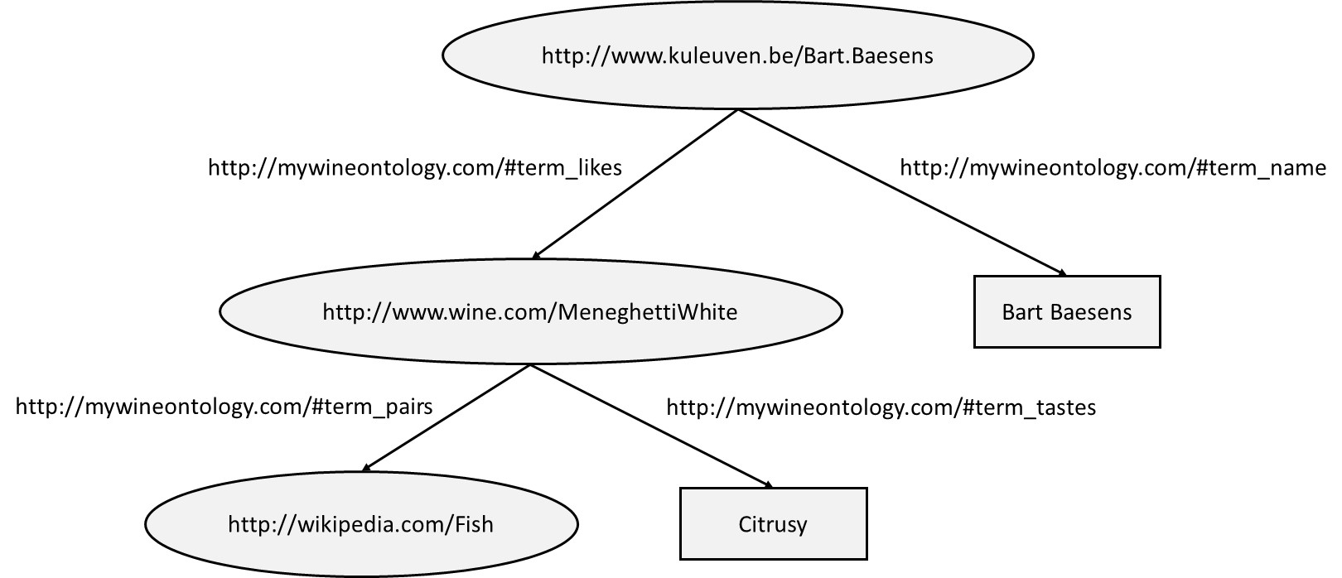
Semantic Search with RDF and SPARQL

Slide 67
Semantic Search with RDF and SPARQL
RDF data can be serialized by means of RDF/XML
<?xml version="1.0"?>
<rdf:RDF xmlns:rdf="http://www.w3.org/TR/PR-rdf-syntax/"
xmlns:myxlmns="http://mywineontology.com/" />
<rdf:Description rdf:about="http://www.kuleuven.be/Bart.Baesens">
<myxlmns:name>Bart Baesens</ myxlmns:name>
<myxlmns:likes rdf:resource="http://www.wine.com/MeneghettiWhite"/>
</rdf:Description>
</rdf:RDF>

Slide 68
Semantic Search with RDF and SPARQL
RDF is one of the key technologies to realize Linked Data
RDF Schema enriches RDF by extending its vocabulary with classes and subclasses, properties and subproperties, and typing of properties
Web Ontology Language (OWL) is an even more expressive ontology language which implements various sophisticated semantic modeling concepts

Slide 69
Semantic Search with RDF and SPARQL
RDF data can be queried using SPARQL (“SPARQL Protocol and RDF Query Language”)
SPARQL is based upon matching graph patterns against RDF graphs
Examples
PREFIX: mywineont: <http://mywineontology.com/>
SELECT ?wine
WHERE {?wine, mywineont:tastes, "Citrusy"}
PREFIX: mywineont: <http://mywineontology.com/>
SELECT ?wine, ?flavor
WHERE {?wine, mywineont:tastes, ?flavor}

Slide 70
XML for Information Exchange
Message Oriented Middleware (MOM)
SOAP-Based Web Services
REST-Based Web Services
Web Services and Databases

Slide 71
Message Oriented Middleware (MOM)
Enterprise Application Integration (EAI): set of activities aimed at integrating applications within an enterprise
EAI can be facilitated by 2 types of middleware
  Remote Procedure Call (RPC): communication is established through procedure calls (e.g., RMI, DCOM); usually synchronous; strong coupling
  Message Oriented Middleware (MOM) integration is established by exchanging XML messages; usually asynchronous; loose coupling

Slide 72
SOAP-Based Web Services
Web services: self-describing software components, which can be published, discovered and invoked through the web
Simple Object Access Protocol (SOAP)
  Extensible, neutral, and independent XML-based messaging framework
<?xml version="1.0" encoding="utf-8"?>
<soap:Envelope xmlns:xsi="http://www.w3.org/2001/XMLSchema-instance"
xmlns:xsd="http://www.w3.org/2001/XMLSchema"
xmlns:soap="http://schemas.xmlsoap.org/soap/envelope/">
<soap:Body>
<GetQuote xmlns="http://www.webserviceX.NET/">
<symbol>string</symbol>
</GetQuote>
</soap:Body>
</soap:Envelope>

Slide 73
SOAP-Based Web Services
Before a SOAP message can be sent to a web service, it must be clear which type(s) of incoming messages the service understands and what messages it can send in return
Web Services Description Language (WSDL) is an XML-based language used to describe the interface or functionalities offered by a web service

Slide 74
SOAP-Based Web Services
<?xml version="1.0" encoding="UTF-8"?>
<wsdl:definitions xmlns:wsdl="http://schemas.xmlsoap.org/wsdl/" targetNamespace="http://www.webserviceX.NET/" xmlns:http="http://schemas.xmlsoap.org/wsdl/http/" xmlns:soap12="http://schemas.xmlsoap.org/wsdl/soap12/" xmlns:s="http://www.w3.org/2001/XMLSchema" xmlns:soap="http://schemas.xmlsoap.org/wsdl/soap/" xmlns:tns="http://www.webserviceX.NET/" xmlns:mime="http://schemas.xmlsoap.org/wsdl/mime/" xmlns:soapenc="http://schemas.xmlsoap.org/soap/encoding/" xmlns:tm="http://microsoft.com/wsdl/mime/textMatching/">
<wsdl:types><s:schema targetNamespace="http://www.webserviceX.NET/" elementFormDefault="qualified">
<s:element name="GetQuote">
<s:complexType>
<s:sequence>
<s:element type="s:string" name="symbol" maxOccurs="1" minOccurs="0"/></s:sequence>
</s:complexType></s:element>
<s:element name="GetQuoteResponse">
<s:complexType>
<s:sequence>
<s:element type="s:string" name="GetQuoteResult" maxOccurs="1" minOccurs="0"/>
</s:sequence>
</s:complexType>
</s:element>
<s:element type="s:string" name="string" nillable="true"/>
</s:schema>
</wsdl:types>
…
</wsdl:definitions>

Slide 75
SOAP-Based Web Services
Web service represented as set of port types that define set of abstract operations
  operation has input message and optional output message (SOAP based)
  message specifies attributes and their types using XML Schema
  port types can be mapped to an implementation (port) by specifying URL
  same WSDL document can refer to multiple implementations
E-business transactions take place according to predefined process model based on web services and XML

Slide 76
REST-Based Web Services
REST (Representational State Transfer) is built on top of HTTP and is completely stateless and light
  less verbose than SOAP
  based on request‐reply functionality, for which HTTP is already perfectly suited
  has become the architecture of choice by “modern” web companies to provide APIs
  REST is tightly integrated with HTTP whereas SOAP is communication agnostic

Slide 77
REST-Based Web Services
HTTP/1.0 200 OK
Content-Type: application/xml
<StockQuotes>
<Stock>
<Symbol>IBM</Symbol>
<Last>140,33</Last>
<Date>22/8/2017</Date>
<Time>11:56am</Time>
<Change>-0.16</Change>
<Open>139,59</Open>
<High>140,42</High>
<Low>139,13</Low>
<MktCap>135,28B</MktCap>
<P-E>11,65</P-E>
<Name>International Business Machines</Name>
</Stock>
</StockQuotes>
GET /stockquote/IBM HTTP/1.1
Host: www.example.com
Connection: keep-alive
Accept: application/xml

Slide 78
Web Services and Databases
Web service can make use of underlying database
Database can act as web service provider or web service consumer
Stored procedures can be extended with WSDL interface and published as web services
  results can be returned as XML (e.g., SQL/XML)
Stored procedures or triggers can include calls to external web services
  E.g., trigger which monitors (local) stock data and if safety stock level is reached automatically generates a (e.g. SOAP) message with a purchase order to the web service hosted by the supplier
Implications on transaction management (e.g. WS-BPEL)!

Slide 79
Other Data Representation Formats
JSON and YAML are optimized for data interchange and serialization
JavaScript Object Notation (JSON) provides a simple, lightweight representation based on name-value pairs
  JSON provides 2 structured types: objects and arrays
  primitive types supported: string, number, Boolean, and null
  JSON is human and machine readable and models data in hierarchical way
  structure of JSON specification can be defined using JSON Schema
  JSON is not a markup language and not extensible
  JSON documents can be parsed using the eval() function
  native and fast JSON parsers in modern day web browsers

Slide 80
Other Data Representation Formats
{
"winecellar": {
"wine": [
{
"name": "Jacques Selosse Brut Initial",
"year": "2012",
"type": "Champagne",
"grape": {
"_percentage": "100",
"__text": "Chardonnay"
},
"price": {
"_currency": "EURO",
"__text": "150"
},

Slide 81
Other Data Representation Formats
{
"_percentage": "20",
"__text": "Pinot Blanc"
}
],
"price": {
"_currency": "EURO",
"__text": "18"
},
"geo": {
"country": "Croatia",
"region": "Istria"
},
"quantity": "20"
}
]
}
}
"geo": {
"country": "France",
"region": "Champagne"
},
"quantity": "12"
},
{
"name": "Meneghetti White",
"year": "2010",
"type": "white wine",
"grape": [
{
"_percentage": "80",
"__text": "Chardonnay"
},

Slide 82
Other Data Representation Formats
YAML Ain’t a Markup Language (YAML) is a superset of JSON with support for relational trees, user-defined types, explicit data typing, lists and casting
  better alternative for object serialization
  uses inline and white space delimiters
  works with mappings, which are sets of unordered key/value pairs and sequences which correspond to arrays
  supports numbers, strings, Boolean, dates, timestamps, and null

Slide 83
Other Data Representation Formats
winecellar:
wine:
-
name: "Jacques Selosse Brut Initial"
year: 2012
type: Champagne
grape:
_percentage: 100
__text: Chardonnay
price:
_currency: EURO
__text: 150
geo:
country: France
region: Champagne
quantity: 12
-
name: "Meneghetti White"
year: 2010
type: "white wine"
grape:
-
_percentage: 80
__text: Chardonnay
-
_percentage: 20
__text: "Pinot Blanc"
price:
_currency: EURO
__text: 18
geo:
country: Croatia
region: Istria
quantity: 20

Slide 84
Conclusions
Extensible Markup Language
Processing XML Documents
Storage of XML Documents
Differences between XML and Relational Data
Mappings Between XML Documents and (Object-) Relational Data
Searching XML Data
XML for Information Exchange
Other Data Representation Formats

Slide 85
More information?
www.pdbmbook.com

